Slide 1


Smart City Insights: Correlating … Delays with Weather
Grebikova Anna, Topór Karol

Slide 2
Concept
Use historic data on disruptions in the public transit system in Vienna
Combine with weather data and geographic data
Try to recognize patterns

Slide 3
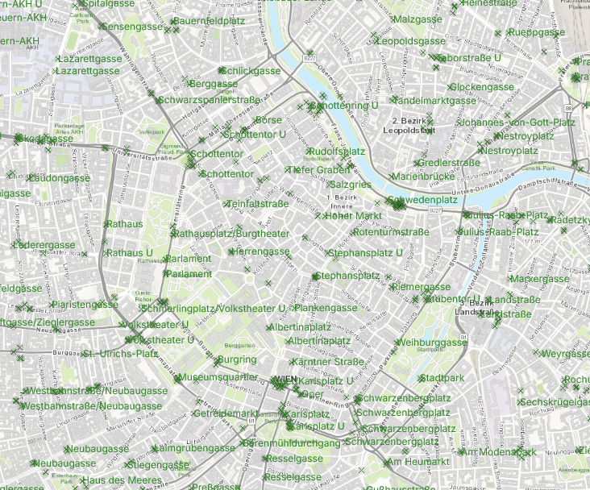


Data Pipeline
Notes:
To get the most accurate weather data the golden solution would be to have some mesuments directly from each stations. (or atleast from areas where stations are)
This could be achived by installing some LoRa WAN Gateways
and some sensors on each station mesuring weather data
which gets feeded into the data pipeline.
BUT since we do not have this possibility we use other data source. (next slide)

Slide 4
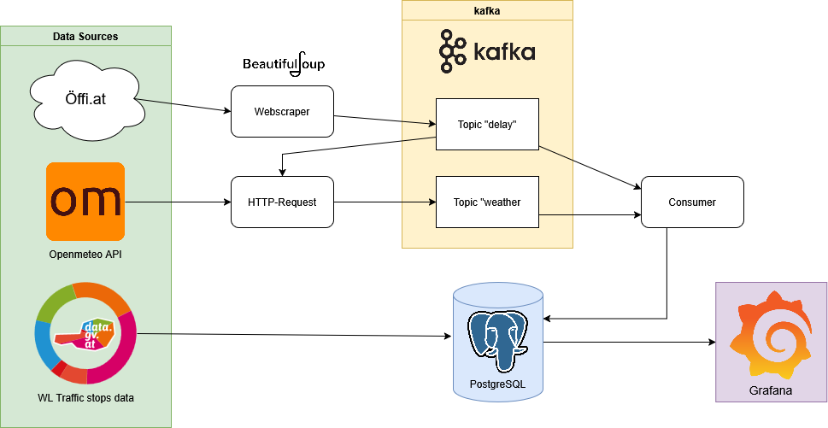

Slide 5
DATA SOURCES
Öffi.at: Web-based historic archive of disruptions in the public transit system
Openmeteo: API for real-time and historic weather data
Data.gv.at: publicly available datasets from Austrian open government data

Slide 6
Data collection
Data from Öffi.at is scraped using BeautifulSoup
Weather data is collected via calls to Openmeteo's API for the timestamps collected from Öffi.at
All of this is streamed to kafka
Geographic information is imported from a csv file from Data.gv.at directly into the database

Slide 7

Data processing
Delay data and Weather data are streamed to two kafka topics
topic_delays
topic_weather
Delay data is consumed to get timestamps for weather data
Then both are consumed and written to the database

Slide 8
Containers
Every part of the system is containerized
Docker is used here
In total, there are 10 containers:

Slide 9
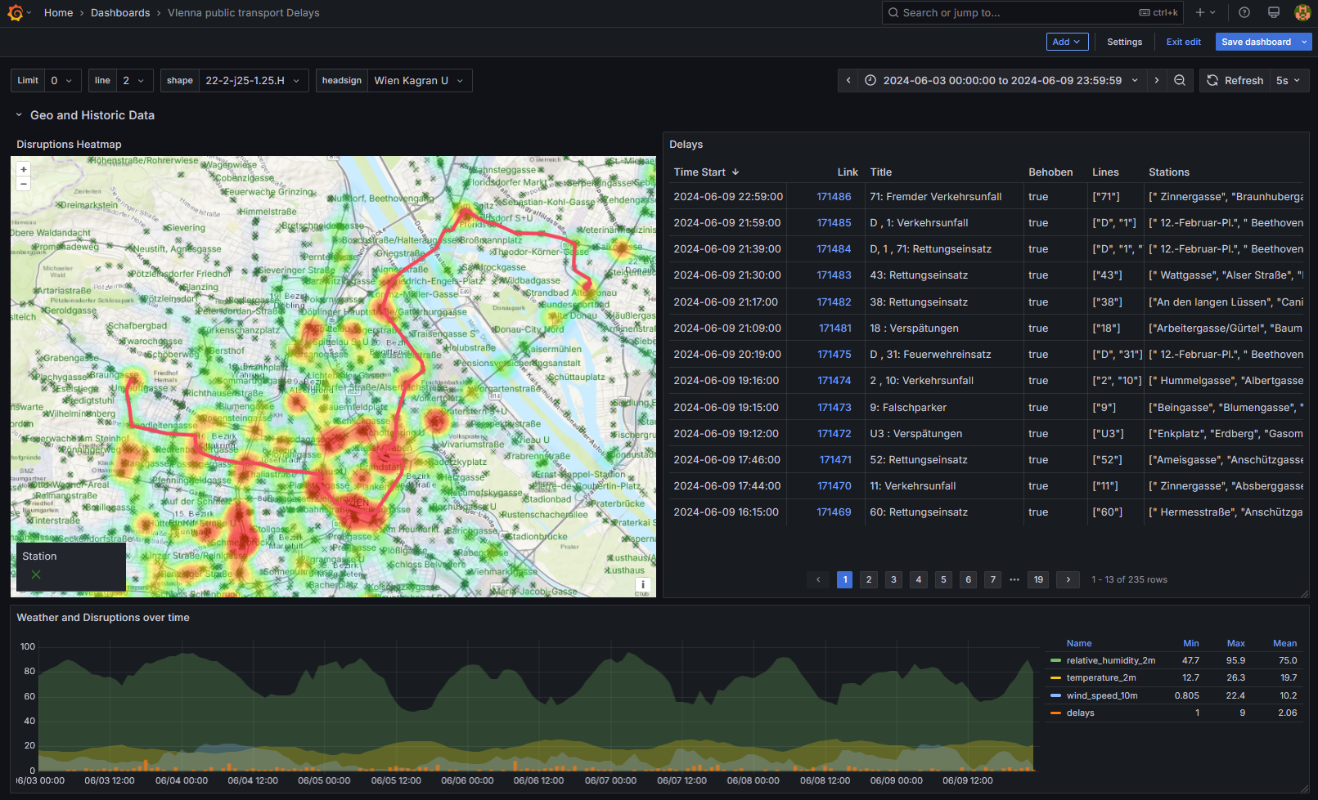
Hands On Part
git clone https://github.com/toporek3112/vienna_public-transport_weather_correlation.git
cd vienna_public-transport_weather_correlation
docker compose up –d
visit http://localhost:13000

Slide 10
Bonus
Find the station with the most diruptions
Find the route with the most diruptions
Find the day with the most disruptions

